Slide 1
DNA Sequencing & Genome Assembly
BIOCHEM 3BP3

Slide 2
Genome references
First genome: Bacteriophage MS2 in 1976 (3.5 Kbp)
First bacterial genome: Haemophilus influenzae in 1995 (1.8 Mbp)
First eukaryote genome: Saccharomyces cerevisiae in 1996 (12.1 Mbp)
First animal genome: Caenorhabditis elegans in 1998 (100 Mbp)
First plant genome: Arabidopsis thaliana in 2000 (119 Mbp)
Human genome in 2001 (3.2 billion bp)

Slide 3
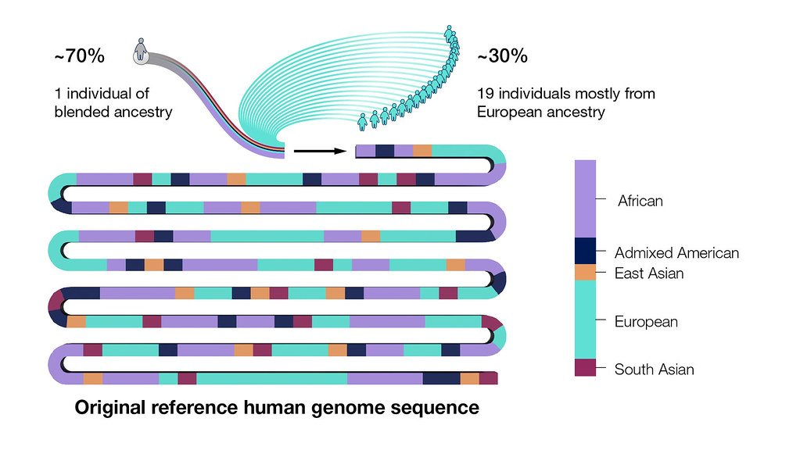
The Human Genome: a single “average” reference
The Human Genome Project (1990-2003)
Original sequence covered 90% and came from 20 volunteers
GRCh38 (2013)
Covered up to 92% of total genome
  Gaps primarily in centromeres & telomeres
Telomere-to-telomere (T2T) (2022)
T2T Consortium released first gapless human genome

Slide 4
Genome Assembly
Genome Assembly is the combined laboratory and computational methods used to determine the genome sequence of an organism
Genome Assembly is highly dependent upon DNA sequencing technologies
Key concepts:
  Read & K-mer
  Phred score
  Mate-Pairs
  Coverage
  Contig
  Scaffold
  Closure & Gaps
https://microbenotes.com/illumina-sequencing/

Slide 5
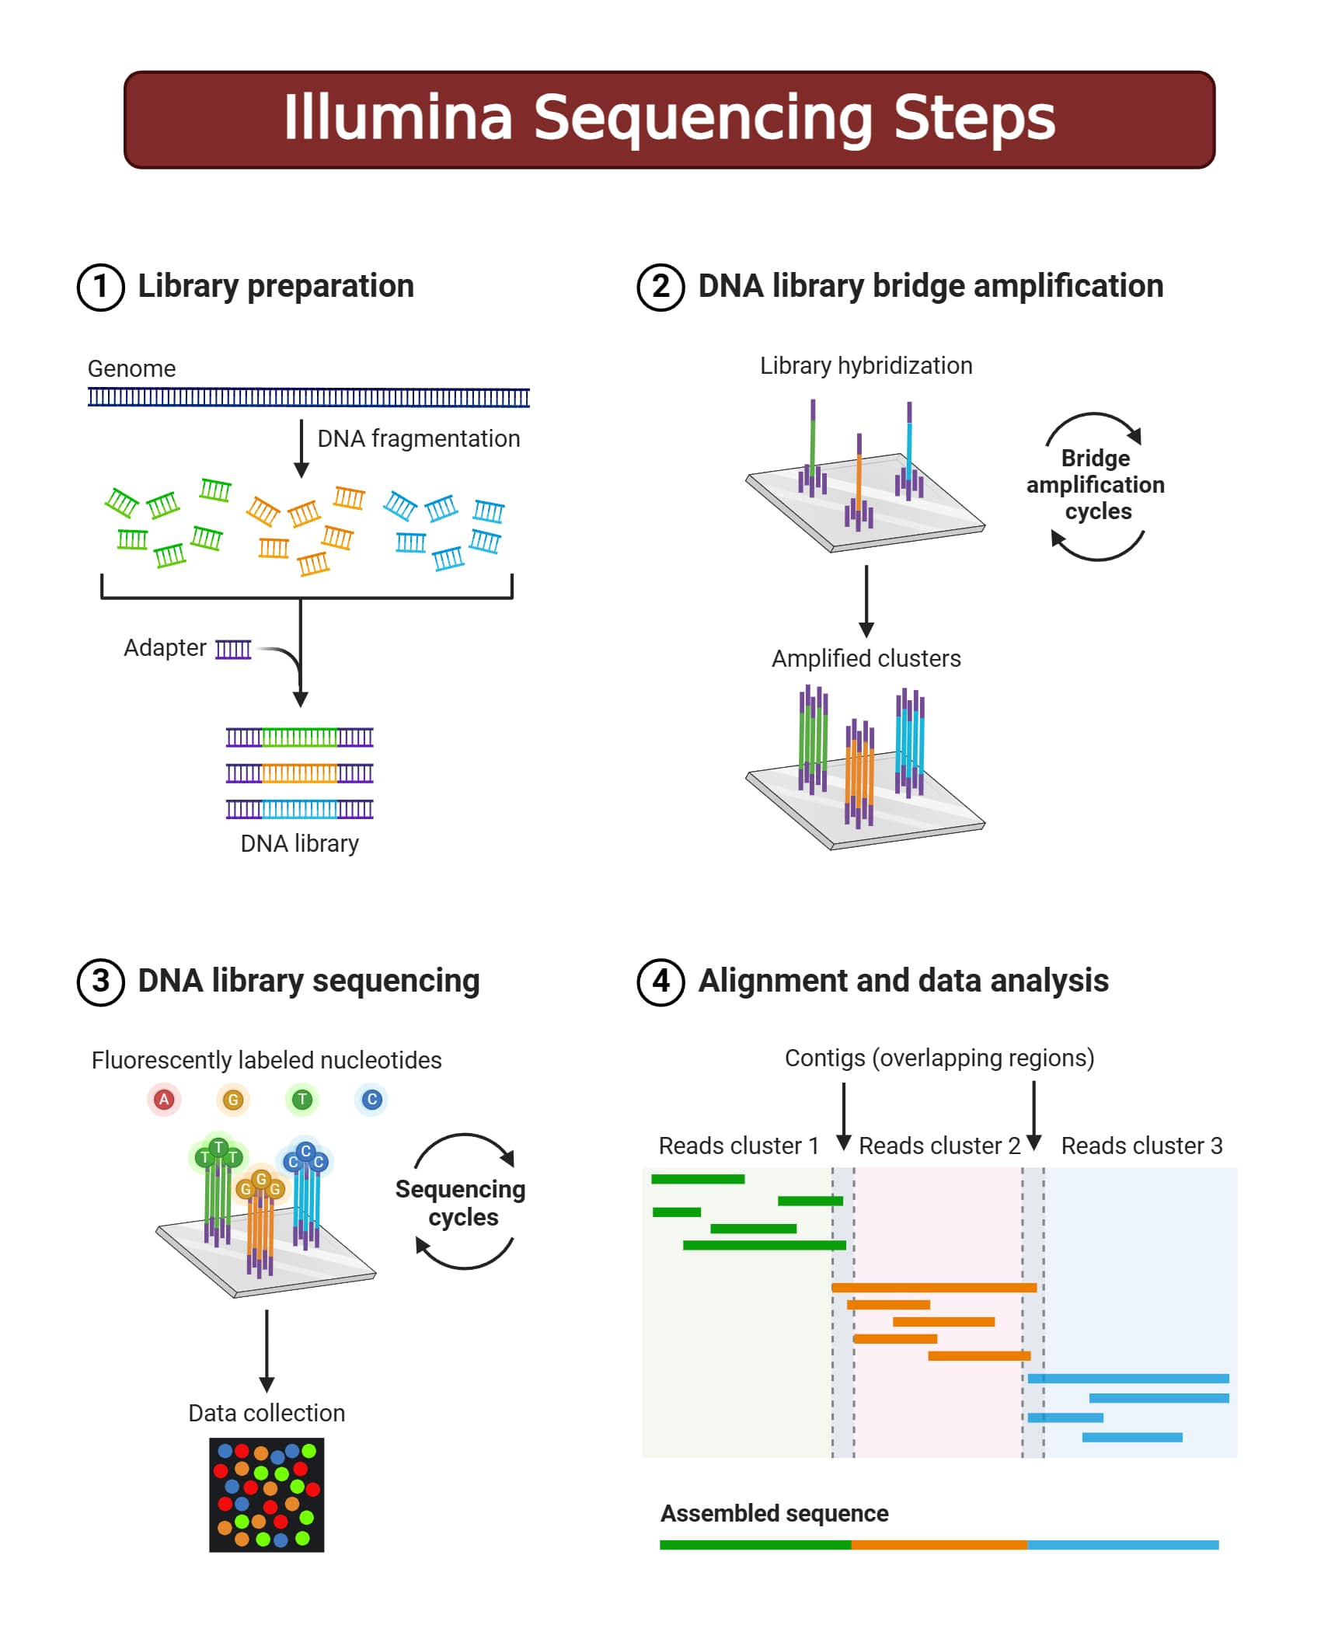
DNA sequencing: Illumina (short read sequencing)
DNA sequencing has an error rate, so a single pass is insufficient
Reads are ~250 bp before chemistry breaks down
https://microbenotes.com/illumina-sequencing/

Slide 6
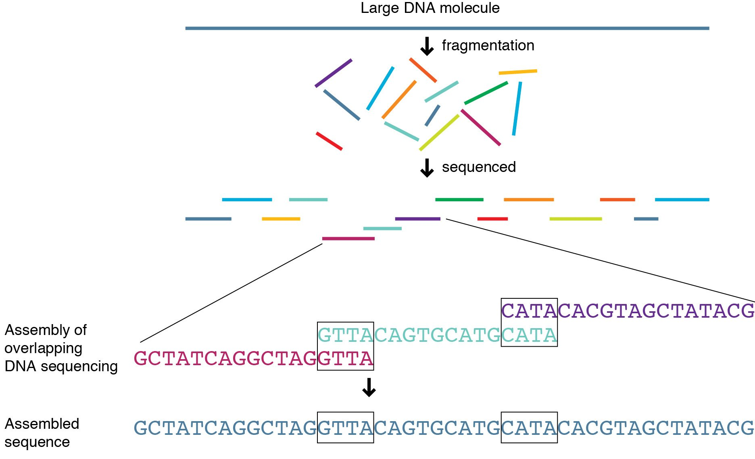
Genome assembly by overlap
http://knowgenetics.org

Slide 7
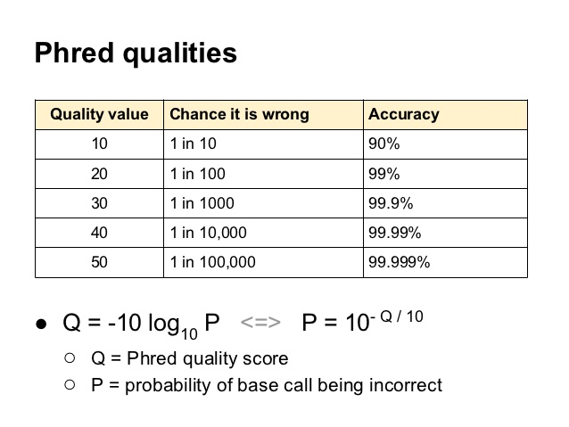
PHRED Score: Quality control of sequencing reads
Before you start your assembly, you need to ensure you have high quality data and account for sequencing errors. Sequencing software uses the PHRED score to measure error
How confidence was the sequencer in the base called?

Slide 8
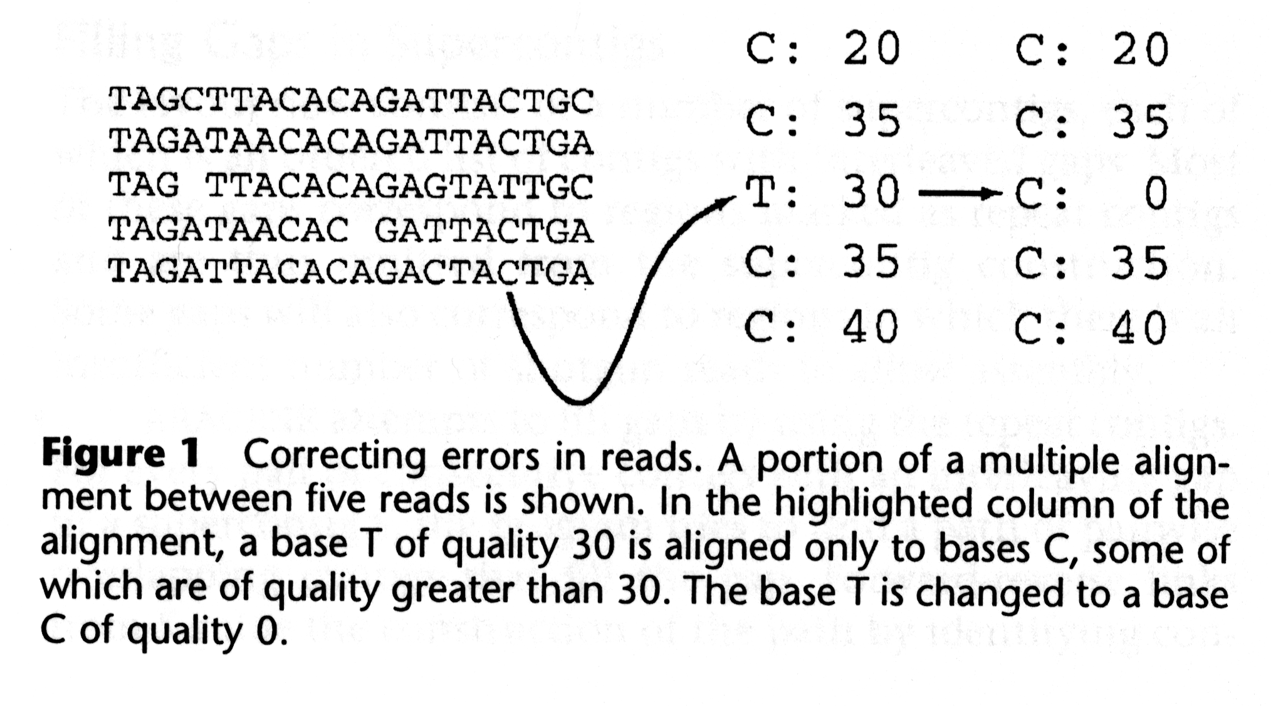
PHRED Score: Quality control of sequencing reads
Before you start your assembly, you need to ensure you have high quality data and account for sequencing errors. Sequencing software uses the PHRED score to measure error
Because we sequenced multiple reads at a given site, we can use this information to correct sequencing errors.
The depth of sampling of a genome is called ”fold coverage”

Slide 9
Genome assembly by overlap
http://knowgenetics.org

Slide 10
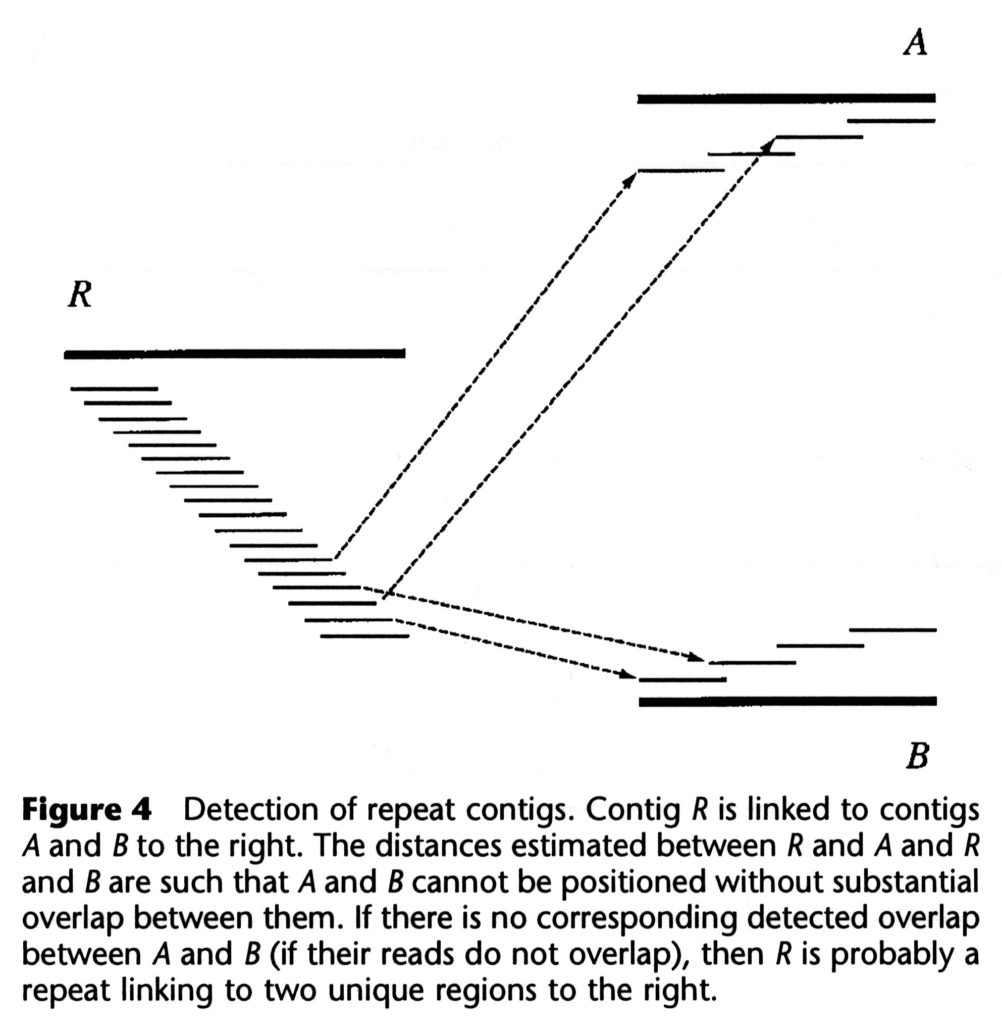
Problem with greedy assembly: Repeats
Greedy algorithms merge reads into consensus ‘contig’ sequences
What if reads are similar but from different parts of the genome?
Greedy algorithms are insufficient to handle this problem

Slide 11
Bi-directional sequence (aka Mate Pairs)
250 bp read (R1)
250 bp read (R2)
1500 bp fragment
R1 and R2 are mate pairs where we know the orientation to each other and the distance between them
Geometry constrains the assembly algorithm
Notes:
As long as one read is from a non-repeat region, it will constrain mate-pair to seembly nearly in the genome

Slide 12
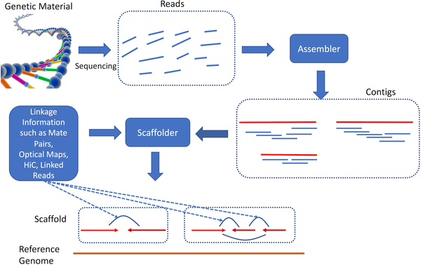
Reads to Contigs to Scaffolds to Genomes
Ghurye et al. PLOS Comp Bio 2019

Slide 13
The A5 microbial genome assembly pipeline
Tritt et al. 2012. PLoS One. 7:e42304.

Slide 14
The A5 microbial genome assembly pipeline
PHRED trimming, error correction – only use high quality data in genomic pipelines!
Tritt et al. 2012. PLoS One. 7:e42304.

Slide 15
The A5 microbial genome assembly pipeline
Tritt et al. 2012. PLoS One. 7:e42304.

Slide 16
The A5 microbial genome assembly pipeline
k-mers, de Bruijn graphs, Eulerian paths, mate-pairs
Tritt et al. 2012. PLoS One. 7:e42304.

Slide 17
The A5 microbial genome assembly pipeline
library size estimation; bad mate-pair geometry
Tritt et al. 2012. PLoS One. 7:e42304.

Slide 18
A5QC / SSPACE ‘Finishing’
library size estimation; bad mate-pair geometry
Tritt et al. 2012. PLoS One. 7:e42304.

Slide 19
A5QC / SSPACE ‘Finishing’
library size estimation; bad mate-pair geometry
Tritt et al. 2012. PLoS One. 7:e42304.

Slide 20
A5QC / SSPACE ‘Finishing’
library size estimation; bad mate-pair geometry
Tritt et al. 2012. PLoS One. 7:e42304.

Slide 21
The A5 microbial genome assembly pipeline
k-mers, de Bruijn graphs, Eulerian paths, mate-pairs
Tritt et al. 2012. PLoS One. 7:e42304.

Slide 22
kmers, de Bruijn graphs, Eulerian paths
There are a wide variety of k-mer assemblers (e.g. Velvet, A5, SPADES, etc.)
Some are generalist others are specialist (e.g. A5 is microbial)
The SPAdes assembler is considered the best microbial genome assembler – uses multiple k-mer sizes
You have seen k-mers before – BLAST word sizes
A k-mer frequency spectrum is generated for a specific k-mer size

Slide 23
kmers, de Bruijn graphs, Eulerian paths
A deBruijn graph is created from the k-mers of all reads
  all k-mers must overlap adjoining k-mers in the genome by k-1
repeat!

Slide 24
kmers, de Bruijn graphs, Eulerian paths
A deBruijn graph is created from the k-mers of all reads
  all k-mers must overlap adjoining k-mers in the genome by k-1
A deBruijn graph can be used to efficiently find read overlap for forming contigs & resolving repeated sequences
  graph theory – the optimal Eulerian path visits every edge exactly once
  repeat regions produce over-abundant k-mers and have identifiable deBruijn graph properties

Slide 25
kmers, de Bruijn graphs, Eulerian paths
Sequencing error creates ‘novel’ k-mers and complicates the deBruijn graph – genome assembly is thus always preceded by an error trimming & correction step
The product of k-mer assembly is a robust set of contigs, but what k-mer size to use?
  Shorter – less memory, more complex deBruijn graph, difficulty with small tandem repeats
  Longer – more memory, simpler deBruijn graph, overcome small repeats, upper maximum due to sequencing gaps, error filtering critical

Slide 26
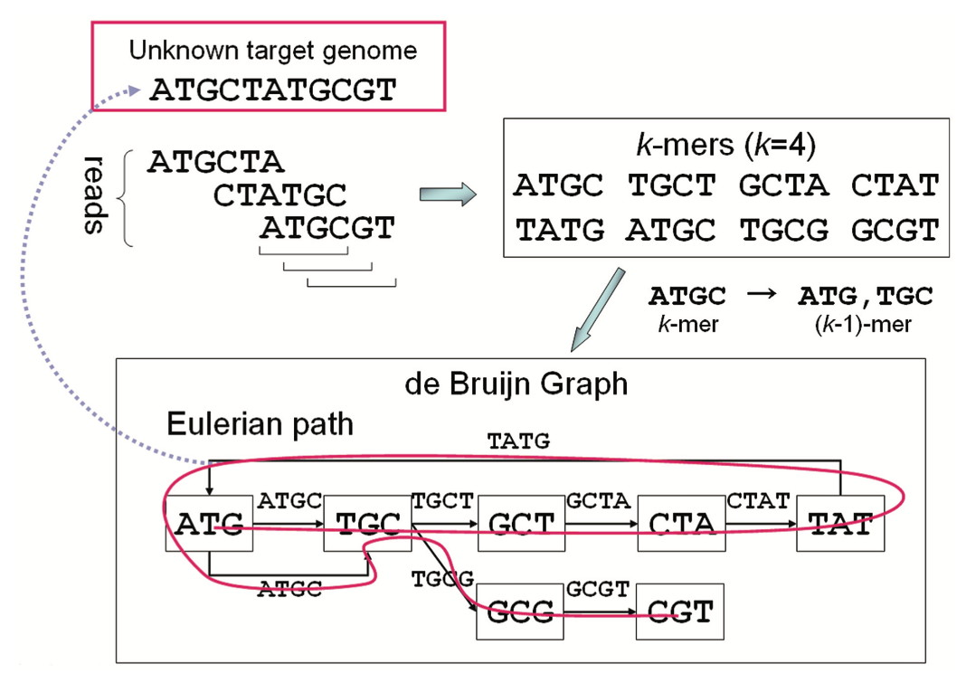
Try this example by hand ...
Demo video on GitHub!
Namiki et al. 2012. Nucleic Acids Research 40:e155

Slide 27
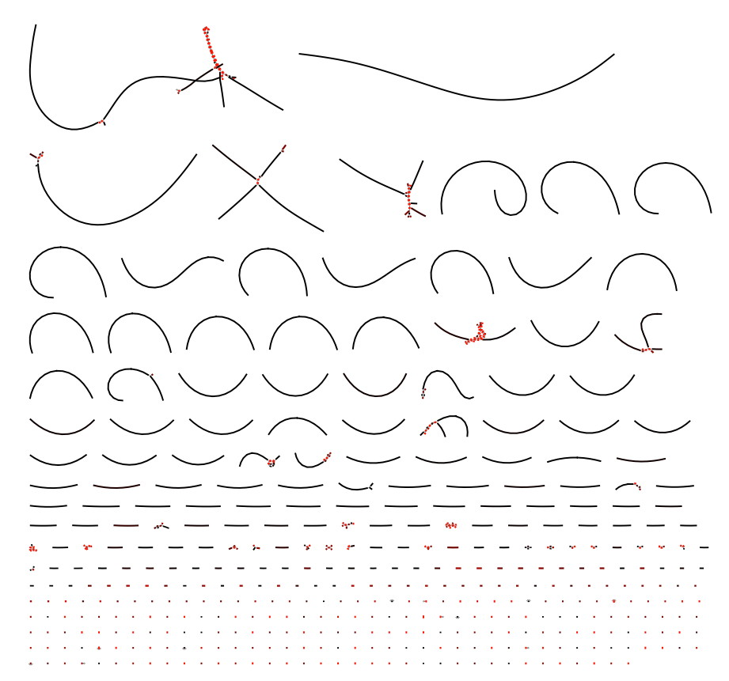
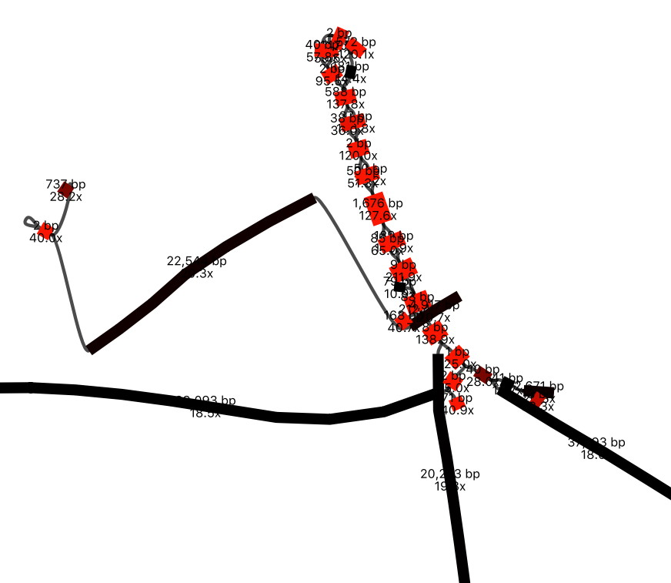
A complete assembly…
BANDAGE visualization

Slide 28
Assembly Statistics – A5 example
McMaster E. coli C008 strain with Illumina HiSeq 2 x 250 bp sequencing
Raw 3,735,008 sequencing reads totaling 933,752,000 bp
~200 fold coverage of the E. coli genome (E. coli K-12 is 4,639,221 bp)
3,666,906 error-corrected reads totaling 797,138,877 bp
98.18% of reads passed error-correction
85.03% of nucleotides passed error-correction
118 contigs in 118 scaffolds
5,247,627 bp sum contig length
bases ≥ Q40 = 5,243,991 (99.9% of assembly; Q40 = 1 in 10,000 error rate)
Longest scaffold = 534,047 bp
Contig N50 = 166,170 bp (at least 50% of the assembly is contained in
contigs of this size or larger)
GC content = 50.6%
Observed read coverage = 178.65 fold
Median = 154 fold; 10th percentile = 97 fold
For a nice review of A5 statistics, see http://tinyurl.com/zwng5cb

Slide 29
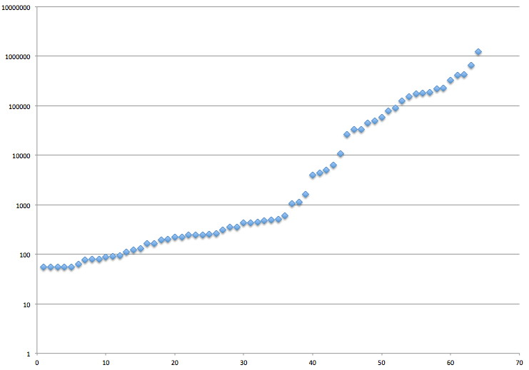
N50
N50 is the size of the contig which, along with all larger contigs, contains half of sequence of an assembly.
sum of all contigs = 4,740,890 bp
1/2 sum of all contigs = 2,370,445 bp
top contig = 1,223,670 bp
this is the N50 contig, with length 405,903 bp
top 2 contigs sum = 1,871,154 bp
top 3 contigs sum = 2,299,813 bp
N50 = 405,903 bp
top 4 contigs contain 1/2 of the assembly, sum = 2,705,716 bp
contig size (bp)
contigs ordered smallest to largest

Slide 30
Finishing, Validation, Confidence
‘Finishing’ traditionally refers to the costly and labourious steps required to ‘close’ all the sequencing gaps to provide high quality and 100% complete chromosome sequences (aka “closure”)
Finishing is workable for bacterial genomes but very hard for eukyarotic genomes
  centromeres and teleomeres are hard to clone or sequence
  yet important biology is encoded in these regions (e.g. Trypanosoma)
Most current genome projects do not attempt closure due to:
  the cost and time involved – closure does not get funded
  shotgun routinely obtains >90% closure and thus the majority of the biology
  gaps will be closed by research teams if it is relevant to their science
‘Finishing’ now most often refers to the scaffolding quality control steps in genome assembly – making the most out of the shotgun data – and is seen as distinct from ‘closure’

Slide 31
Finishing, Validation, Confidence
Validation of genome assembly is difficult as our knowledge about the genome we are sequencing is often limited
If a closely related genome sequence is known, a comparison can be made to determine possible errors – or are they real differences?
Genome annotation can identify gaps in the assembly (e.g. missing genes known from PCR or biochemistry)
With limited prior knowledge, bioinformaticians rely on the assembly statistics such as Q40, N50, etc.
But can we trust the assembly software?
  Peer-reviewed publication of algorithms and open source release of software
  Head-to-head comparison of assemblers on the same data to identify consensus
  Simulated data and Assemblathon / GAGE competitions

Slide 32
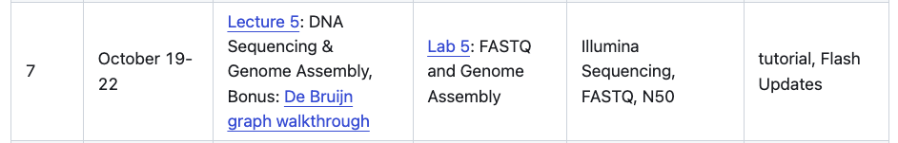
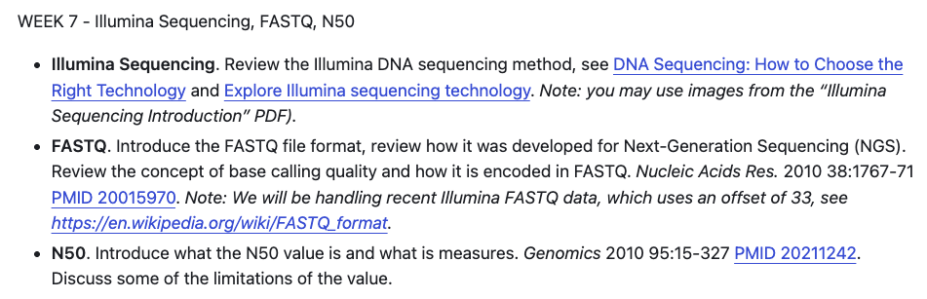
This week …

